Slide 1

2018 Animal violence Insights
A look at Maricopa County Animal Control

Slide 2

Agenda
Trends Dashboard & Heat Map
Statistical Correlation Testing Results
Statistical t-Test Results
Presentation Takeaways

Slide 3
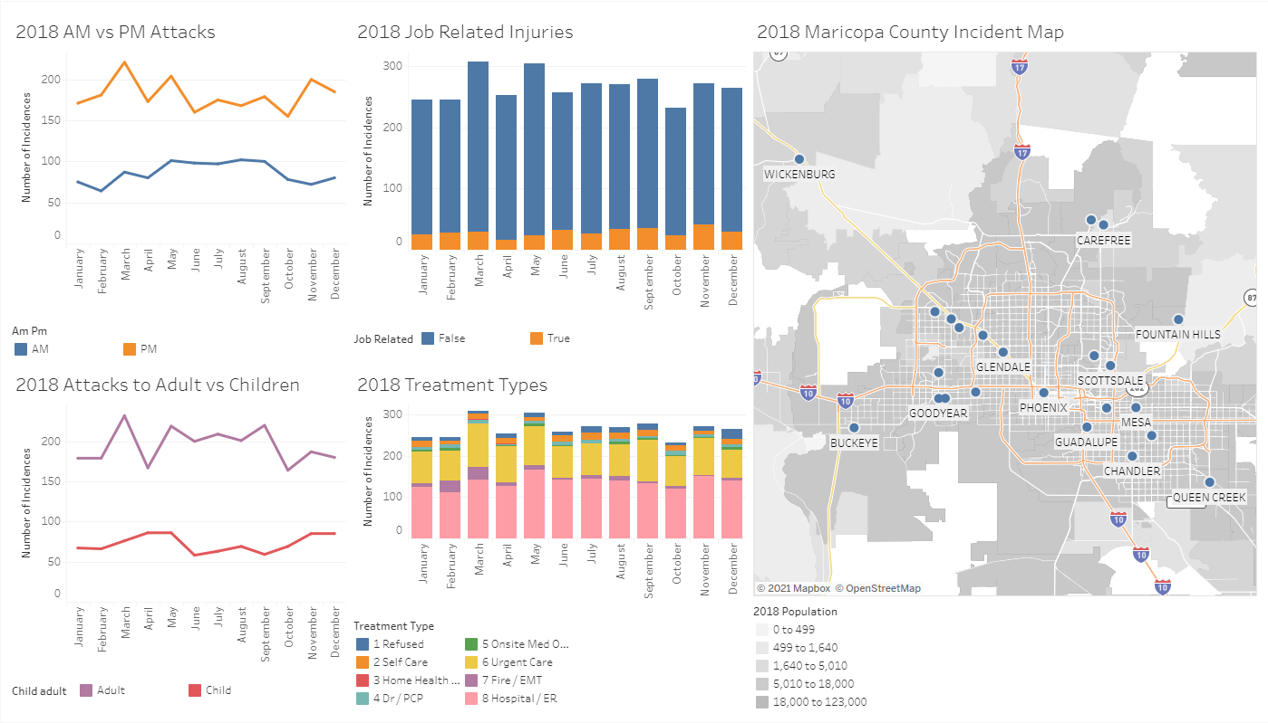
Overall Month to month trends
Dashboard - Month to Month Trends

Slide 4
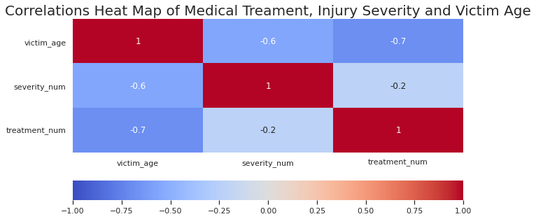
Over all data correlations Heat map

Slide 5
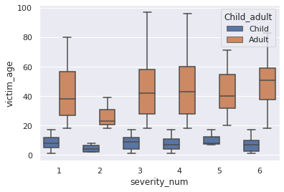
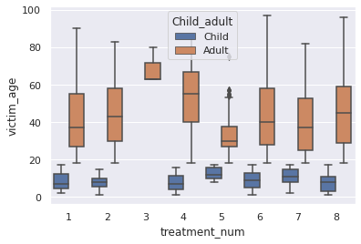

Statistical Correlation test - I
Are children more vulnerable than adults regarding animal related injuries?
Is there a correlation between animal related injuries due to the age of a human and severity?
Accept the null that there is no correlation of the population means of between animal related injuries due to the age of a human and severity

Slide 6
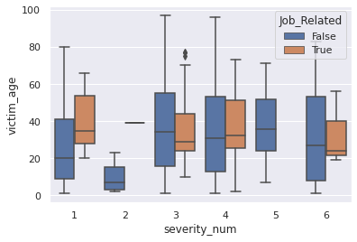
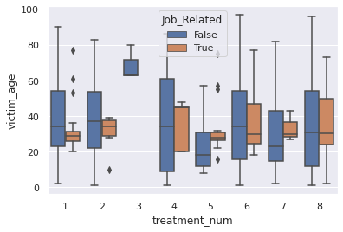

Statistical Correlation test - II
Are injuries with job related activities more common than others?
Is there a correlation between animal related injuries with job related activities?
Accept the null that there is no correlation of the population means of animal related injuries with job related activities

Slide 7
Statistical T-test - I
Are we encouraging people enough to seek professional medical care over self-care choices enough?
Is there a statistical significance between medical care and self-care choices?
Accept the null that there is no difference between the population means of medical care and self-care choices after animal related injuries.

Slide 8
Statistical T-test - II
Are animal related injuries more common in the Morning or Afternoon?
Is there a statistical significance between Morning and Afternoon related injuries?
Accept the null that there is no difference between the population means of Morning and Afternoon related injuries?

Slide 9

Presentation takeaways
Having only one year of accumulative data:
Does not provide a true picture of trends and statistical base data.
The raw data provided to me was very unorganized:
Recommend that database upgrade be completed that included less open text fields to allow for better statistical analysis.
Ensuring the public at large:
Receives appropriate medical care for animal related injuries that break skin to prevent infection.
Registers animals with the Maricopa County Animal Control.
Micro chips animals to help ensure that animals are safely returned home.
Vaccines are up to date to protect public health and the health of their pets.

